Slide 1
Intro to FTC Code
Don’t panic!
https://github.com/JimWright4089/FIRSTWorkshops

Slide 2
Intro
Things covered in this class:
Setting up the phones
Block Programming
OnBot Java

Slide 3
Setting up the phones
You need two phones
Check the rules for which ones:
ZTE Speed • Motorola Moto G 2nd Generation • Motorola Moto G 3rd Generation • Motorola Moto G4 Play • Google Nexus 5 • Samsung Galaxy S5
One to be the Robot Controller, Google Play has the FTC Robot Controller tool.
One to be the Drivers Station. Google Play also has that tools.
https://github.com/JimWright4089/FIRSTWorkshops

Slide 4
Setting up the phones
Under the settings you will find tools to set the names of the phones.
<team number>-DS for Driver station
<team number>-RC for Robot Controller
Spare phones user letters between the team number and the –XX. Like 4444-B-RC

Slide 5
Setting up the phones
Connect the Driver station to a joystick, or hub with two joysticks connected to it, through a OTG cable.
Connect the Robot Controller to the Robot through a Mini B to Micro B cable.

Slide 6
Setting up the phones
The Robot controller needs a Robot Configuration to run.
When you name things in the configuration, you must use those names in the programs.

Slide 7
Programming
You have a bunch of ways to program your robot.
Block
OnBot
Andriod Studio

Slide 8
Block and OnBot connection.
You will enable another WIFI connection to the Robot Controller
Use the Program and Manage menu item.
From this panel you will see the WIFI name and WIFI key for the robot controller

Slide 9
Block and OnBot connection.
You will enable another WIFI connection to the Robot Controller
Use the Program and Manage menu item.
From this panel you will see the WIFI name and WIFI key for the robot controller.
Point your browser to the IP address on the RC. Something like:
http://192.168.49.1:8080

Slide 10
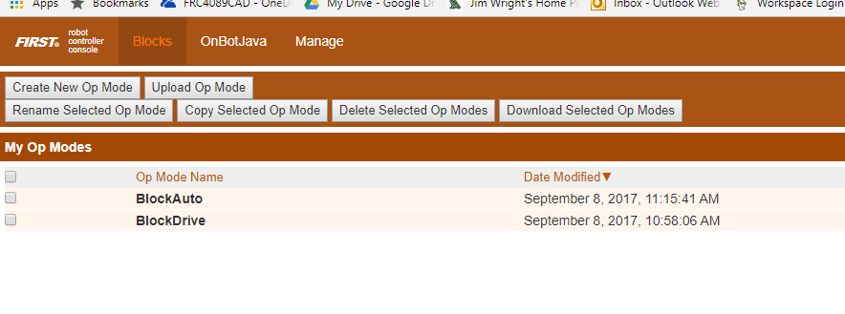
Block
Screen:

Slide 11
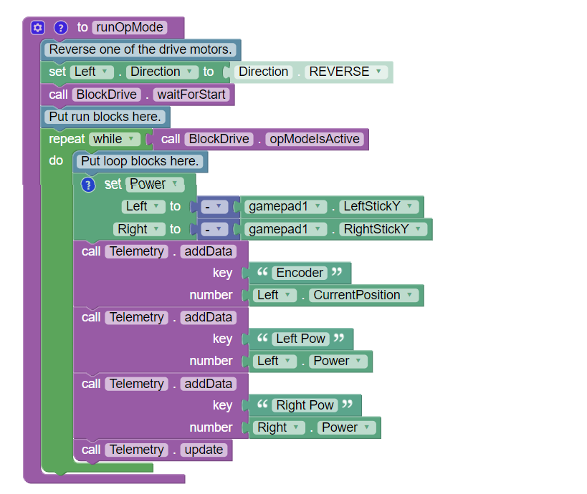
Block

Slide 12
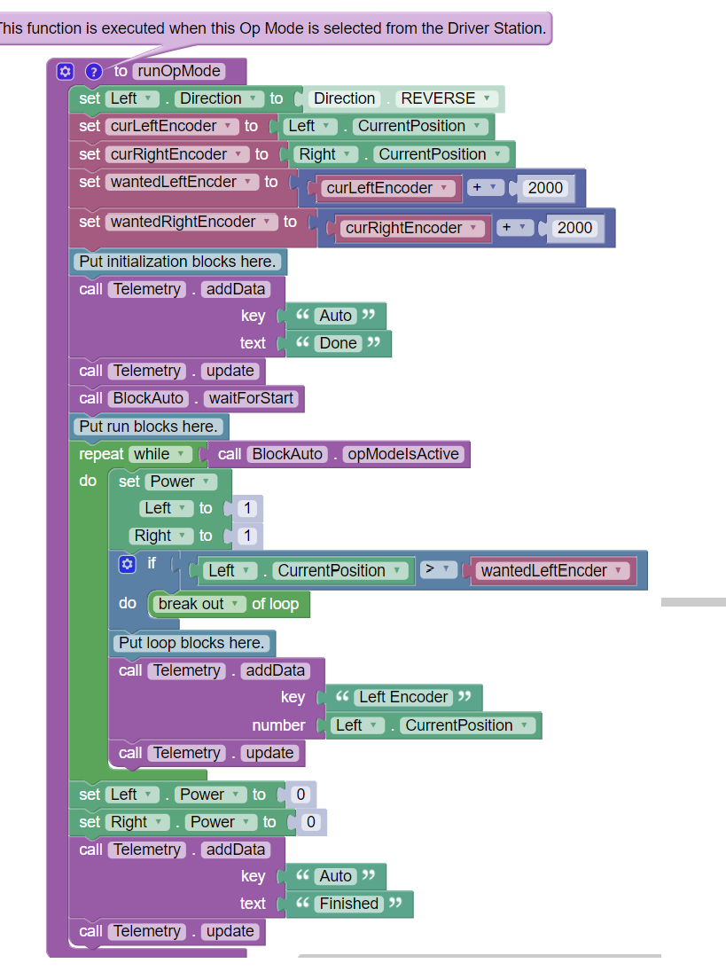
Block

Slide 13
OnBot
Standard Java, just on the robot!

Slide 14
OnBot
rightMotor = hardwareMap.dcMotor.get("Right");
rightMotor.setDirection(DcMotor.Direction.REVERSE);// Set to FORWARD if using AndyMark motors
rightMotor.setMode(DcMotor.RunMode.STOP_AND_RESET_ENCODER);
rightMotor.setMode(DcMotor.RunMode.RUN_WITHOUT_ENCODER);
waitForStart();
runtime.reset();

Slide 15
OnBot
while (opModeIsActive()) {
Integer rightEnc = rightMotor.getCurrentPosition();
telemetry.addData("Status", "Run Time: " + runtime.toString());
telemetry.addData("R Enocder", rightEnc.toString());
telemetry.update();
leftMotor.setPower(-gamepad1.left_stick_y);
rightMotor.setPower(-gamepad1.right_stick_y);

Slide 16
Color Sensor
Run the Color Sensor Example

